Slide 1

State management in php cookies and session

Slide 2
The anatomy of a cookie
Cookies are usually set in an HTTP header (although JavaScript can also set a cookie directly on a browser).

Slide 3
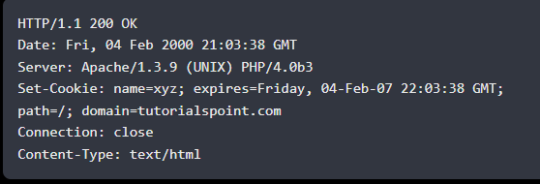
The anatomy of a cookie
A PHP script that sets a cookie might send headers that look something like this −

Slide 4
What is a cookie ?
A cookie is a small file that the server embeds on the user's computer.

Slide 5
What is a cookie ?
Each time the same computer requests a page with a browser, it will send the cookie too.
A cookie is often used to identify a user.
With PHP, you can both create and retrieve cookie values.

Slide 6
Setting a cookie with php
A cookie is created with the setcookie() function.
SYNTAX
Setcookie(name, value, expire, path, domain, secure, httponly);
Note 1: Only the name parameter is required . All other parameters are optional.
Note 2: The setcookie() function must appear BEFORE the <html> tag.

Slide 7
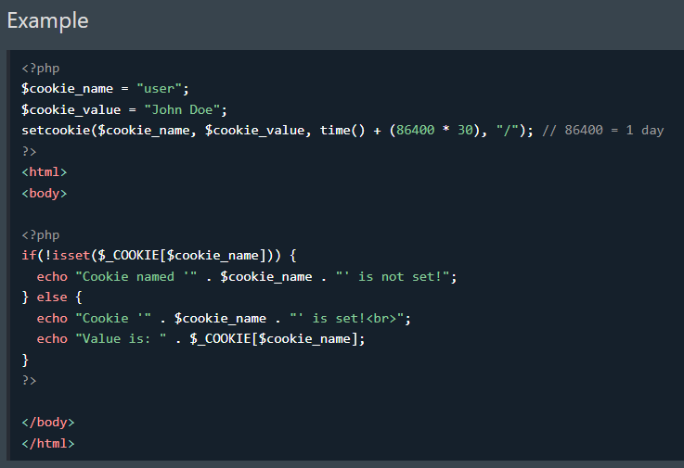

Slide 8
Deleting a cookie
To delete a cookie, use the setcookie() function with an expiration date in the past:

Slide 9
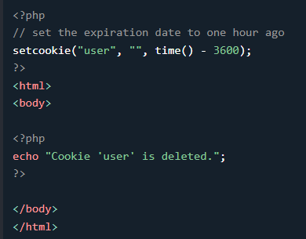
Deleting a cookie (example)

Slide 10
Creating session cookie
Session cookies are cookies that last for a session.
A session starts when you launch a website or web app and ends when you leave the website or close your browser window.
Session cookies contain information that is stored in a temporary memory location which is deleted after the session ends.
Unlike other cookies, session cookies are never stored on your device
Therefore, they are also known as transient cookies, non-persistent cookies, or temporary cookies.

Slide 11
Working with the query string
What is a query string ?
A query string is a part of a Uniform Resource Locator (URL) that assigns values to specified parameters.
Note 1: Page URL and the parameters are separated by the ? character.

Slide 12
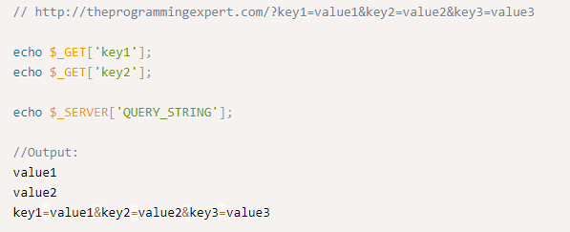
Working with the query string
How to get the (value) from a query string from a URL
To get the query string from a URL in php, you can use $_GET super global to get specific key value pairs or $_SERVER['QUERY_STRING’] super global to get the entire string.

Slide 13
Working with the query string
How to get the parameters from a URL
The parameters from a URL string can be retrieved in PHP using parse_url() and parse_str() functions.

Slide 14
Working with the query string
parse_url() Function
The parse_url() function is used to return the components of a URL by parsing it. It parse an URL and return an associative array which contains its various components.
SYNTAX
parse_url( $url, $component = -1 )

Slide 15
Working with the query string
parse_str() Function
The parse_str() function parses a query string into variables.
Note: If the array parameter is not set, variables set by this function will overwrite existing variables of the same name.
SYNTAX
parse_str(string, array)

Slide 16

Working with the query string
parse_str() Function (Parameter)
string: Required. Specifies the string to parse.
Array: Optional (Required from PHHP 7.2). Specifies the name of an array to store the variables. This parameter indicates that the variables will be stored in an array.

Slide 17
Working with the query string
parse_url and parse_str() Function (Example)
<?php
// Initialize URL to the variable
$url = 'https://www.geeksforgeeks.org?name=Tony';
// Use parse_url() function to parse the URL
// and return an associative array which
// contains its various components
$url_components = parse_url($url);
// Use parse_str() function to parse the
// string passed via URL
parse_str($url_components['query'], $params);
// Display result
echo ' Hi '.$params['name'];
?>
Output: Hi Tony

Slide 18
Creating query string
http_build_query() Function
The http_build_query() function is an inbuilt function in PHP which is used to generate URL-encoded query string from the associative (or indexed) array.
SYNTAX
http_build_query( $query_data, $numeric_prefix, $arg_separator, $enc_type = PHP_QUERY_RFC1738 )
Note 1: It returns a URL-encoded string.

Slide 19
Creating query string
http_build_query() Function (Parameters)
$query_data: This parameter holds the array or object containing properties which are given below:
It may be a single dimensional array or multi-dimensional array.
If $query_data is an object then only public property will be incorporated into the result .
$numeric_prefix: This parameter is used if numeric indices are used in the base array, it will be prepended to the numeric index for elements in the base array only.
$arg_separator: It is used to separate arguments but may be overridden by specifying this parameter.
$enc_type: Its default value is PHP_QUERY_RFC1738.

Slide 20
Creating query string
http_build_query() Function (Example)
<?php
$info = array(
'sudo' => 'placement',
'CPP' => 'course',
'FORK' => 'C',
);
echo http_build_query($info) . "#";
echo http_build_query($info, '', '&');
?>
Output: sudo=placement&CPP=course&FORK=C#sudo=placement&CPP=course&FORK=C

